Slide 1
Computer Networks and Internets
《计算机网络与因特网》课件
林坤辉

Slide 2
PART IV Internetworking
Chapter 22（2）
IP Encapsulation, Fragmentation, and Reassembly
I P封装、分段与重组

Slide 3

22.2 Datagram Transmission and Frames
IP software first selects the next hop,
Then transmits the datagram across a physical network.
Network hardware does not understand datagram format or Internet addressing.
Each hardware technology defines a frame format and a physical addressing scheme.

Slide 4
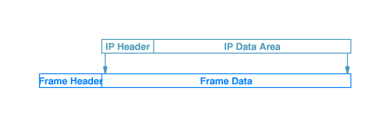
22.3 Encapsulation封装
encapsulation.
The hardware does not examine or change the contents of the frame data area.
The sender and receiver must agree on the value used in the frame type field.
The sender must supply the physical address of the next computer to which the datagram should be sent.

Slide 5
22.4 Transmission Across an Internet
When a frame reaches the next hop,the receiving software extracts the IP datagram and discards the frame header.
If the datagram must be forwarded across another network , a new frame is created.
Frame headers do not accumulate during a trip through the internet.
Hosts and routers store a datagram in memory with no additional header.

Slide 6
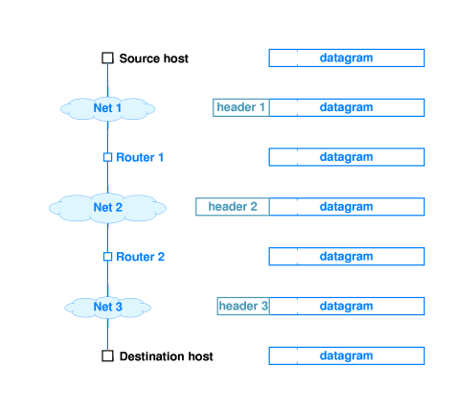

Slide 7
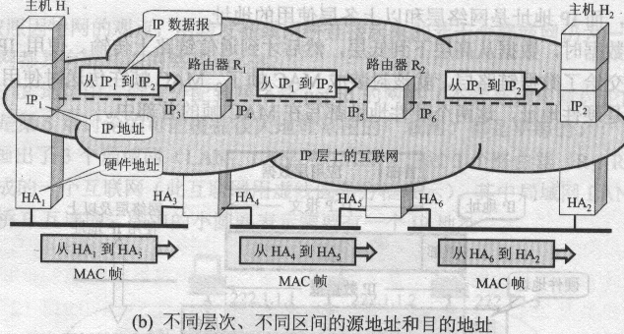

Slide 8
最大传输单元（MTU）(1)
什么是最大传输单元
  链路层数据帧支持的最大传输字节数
C1
C2
MTU=1200B
MTU=800B
R1
R2
R3
N1
N2
MTU=600B
N3
MTU=800B
MTU=1500B
C3
R4
R6
R5
N5
N4
C5
C4

Slide 9

最大传输单元（MTU）(2)
路径上最大传输单元对IP报文大小的影响
  按照端到端路径上最大MTU作为IP报文长度
    1500B
  按照端到端路径上最小MTU作为IP报文长度
    600B
  按照当前链路上MTU作为IP报文长度
    1500B
    1200B
    1000B
    800B
    600B

Slide 10
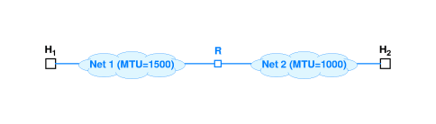
22.5 MTU,Datagram Size, and Encapsulation
Protocol MTU
Token ring(16Mbps) | 17914
Token ring (4Mbps) | 4464
FDDI | 4352
Ethernet | 1500
X.25 | 576
PPP | 296

Slide 11
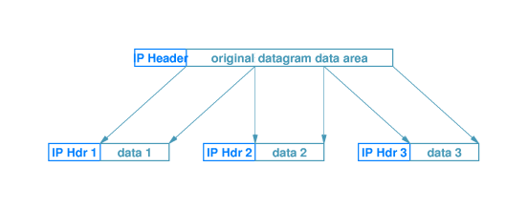
The router divides the datagram into smaller pieces called fragments.
Each fragment uses the IP datagram format.
sends each fragment independently.

Slide 12

IP报文的分片策略(1)
IP报文传输的分片策略
  在不超过版本本身规定大小的前提下，采用当前最合适的报文长度
  在当前链路帧长度小于IP数据报文的时候，将IP报文分成较小的几个分片进行传输
  分片原则
    各片尽可能大，但是必须能为帧所封装
    片大小必须为8的整数倍

Slide 13
IP报文的分片策略(2)
分片大小根据MTU、IP报文头长度（基本长度为20字节）计算
IP头
580B
20B
IP头
580B
IP头
1480B
IP头
320B
R4
R3
R5
N4
N3
MTU=1500B
C4
MTU=600B
C3

Slide 14
分片信息表示
IP报文中的相关信息
  IP报文中的ID
    始终保持初始ID不变
  标志位
    如果第一次分片，则修改“是否已经分片”相应位
  片偏移量
    表示当前分片在初始IP包中有效数据的偏移位置（IP包中以8字节为单位）
偏移量 = 0
IP头
580
偏移量= 580
IP头
580
偏移量=1160
IP头
320

Slide 15
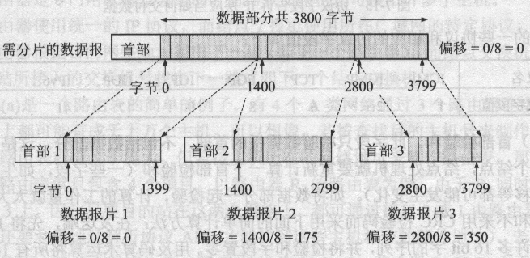

Slide 16
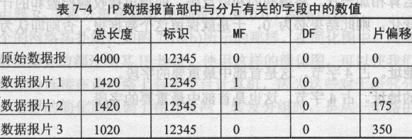
标志 MF(more fragment), MF=1 表示后面还有分片；MF=0 表示这是最后一个分片；DF(don’t fragment), DF=1 表示不允许分片；DF=0 表示允许分片。

Slide 17
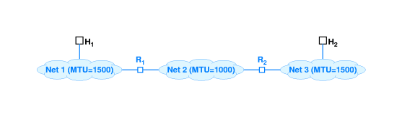
22.6 Reassembly重组
The process of creating a copy of the original datagram from fragments is called reassembly.
IP specifies that the ultimate destination host should reassemble fragments.

Slide 18
22.7 Identifying A Datagram
A sender places a unique identification number in the IDENTIFICATION field of each outgoing datagram.
When a router fragments the datagram,the router copies the identification number into each fragment.

Slide 19

IP报文的重组
报文重组策略
  源端到目标端数据传输过程中可能有多次分片
    数据报文大小一定不会大于路径上的最小MTU
  所有传输的分片重组在目标端进行
  中间路由设备不做分片重组
    减少中间节点的数据处理过程

Slide 20
22.8 fragment Loss
Some fragment are delayed or lost.
Receiver must save the fragments.
IP specifies a maximum time to hold fragments.
Either all fragments arrive and IP reassembles the datagram, or IP discards the complete datagram.
There is no mechanism for a receiver to tell the sender which fragments have arrived.
If the sender did retransmit the datagram,routes may be different.

Slide 21
IP报文丢失问题
IP报文丢失判断
  目标端对IP报文分片作重组处理的时候进行丢失判断
  对应于源端发出的每一个报文，在收到第一个分片的时候，给出一个等待的有限时间T-out，如果T-out之后还没有收到全部分片，则为超时
  任何一个分片丢失或数据出错，则丢弃整个报文

Slide 22
22.9 Fragmenting A fragment
The fragmentation scheme has been planned carefully to make it possible to further fragment a fragment.

Slide 23
作业
从C1向C5发送一个IP报文（报文总长1200B），给出此IP报文在N1、N2、N3、N4、N5中的每个分片的大小及其偏移量。（ IP报头20字节）
C1
C2
MTU=1200B
MTU=800B
R1
R2
R3
N1
N2
MTU=600B
N3
MTU=800B
MTU=1500B
C3
R4
R6
R5
N5
N4
C5
C4

